Slide 1

Lucky coffee shop
By:Jakab Máté
Ujvárosi Gábriel
Fuglovics Konor
Fekete Zoltán
Kispál Marcell

Slide 2
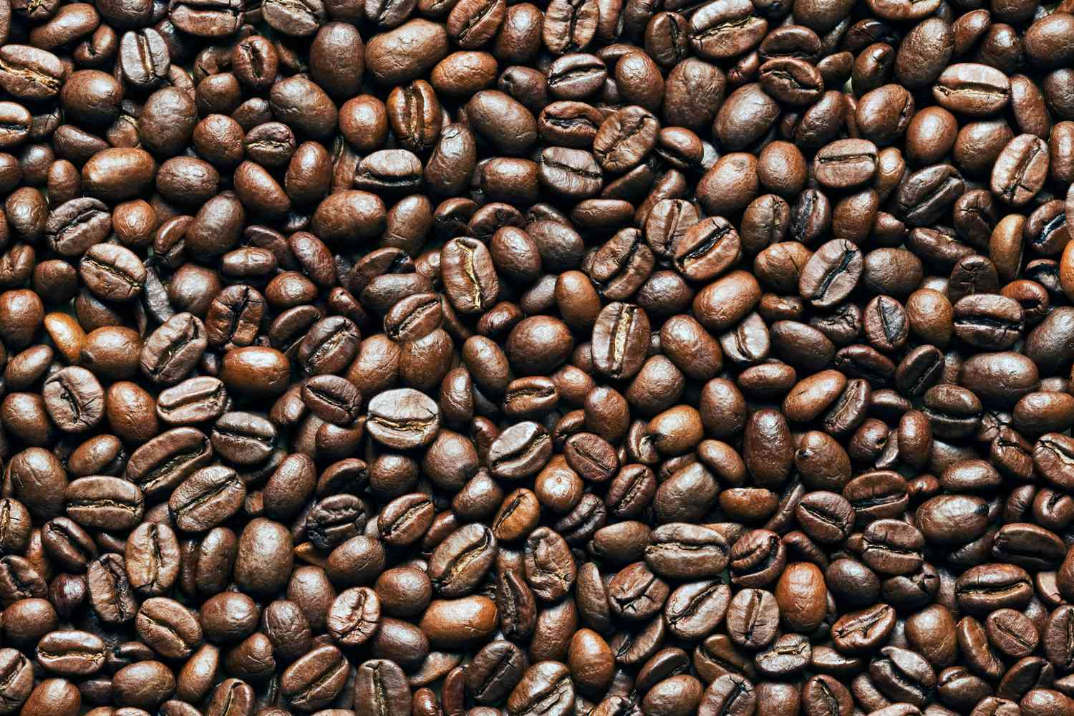
Customers Expectations
The webpage be valid
Work(optional)
The Cake/Drinks be in a good price
The quality of our Cakes
Rapid responsive time

Slide 3
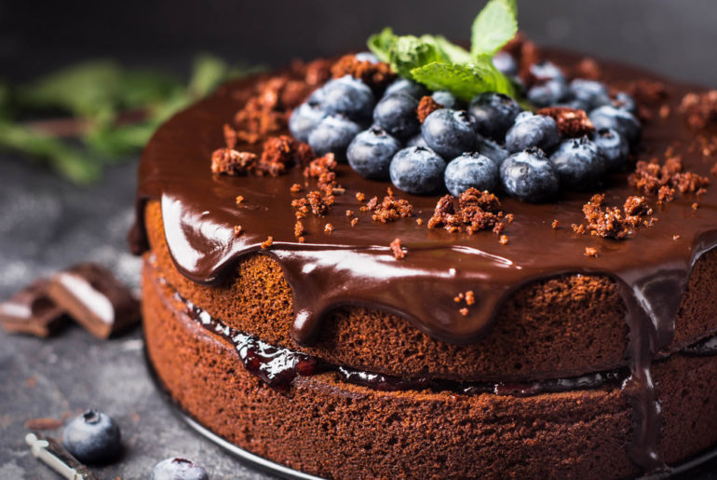
Pages
Main page:Obviusly we need an opening page
Coffee types:The main part of the webpage,on this page will be the coffee’s that the Coffee shop sell,and one of the coffee’s will be marked as the daily offer
Blog:Mainly for the search engine optimalization. It features articles and interesting stories.
Drinks:There are all kind of drinks you can order.
Cakes:On this page we show all kind of cakes you can order

Slide 4
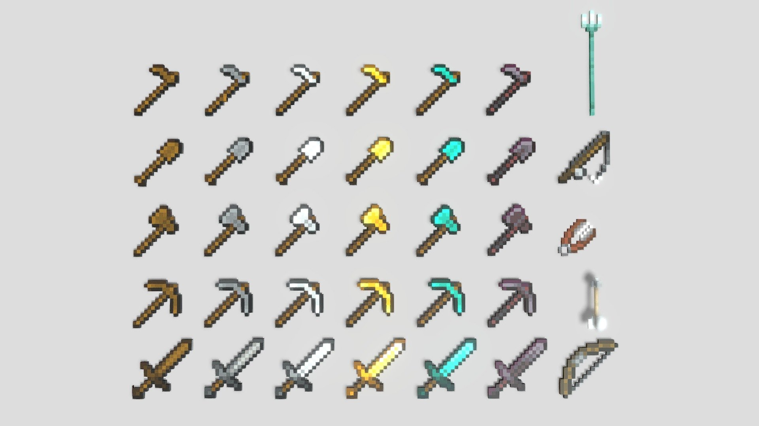
Tools
Trello:We used this to see how our work goes on the webpage and decided how to share our work.
Figma:This is the tool that we used to designe the webpage looks.
Github:This is where we shared and saved our files
Bootstrap:An HTML Library that we used for our webpage to be more responsive

Slide 5
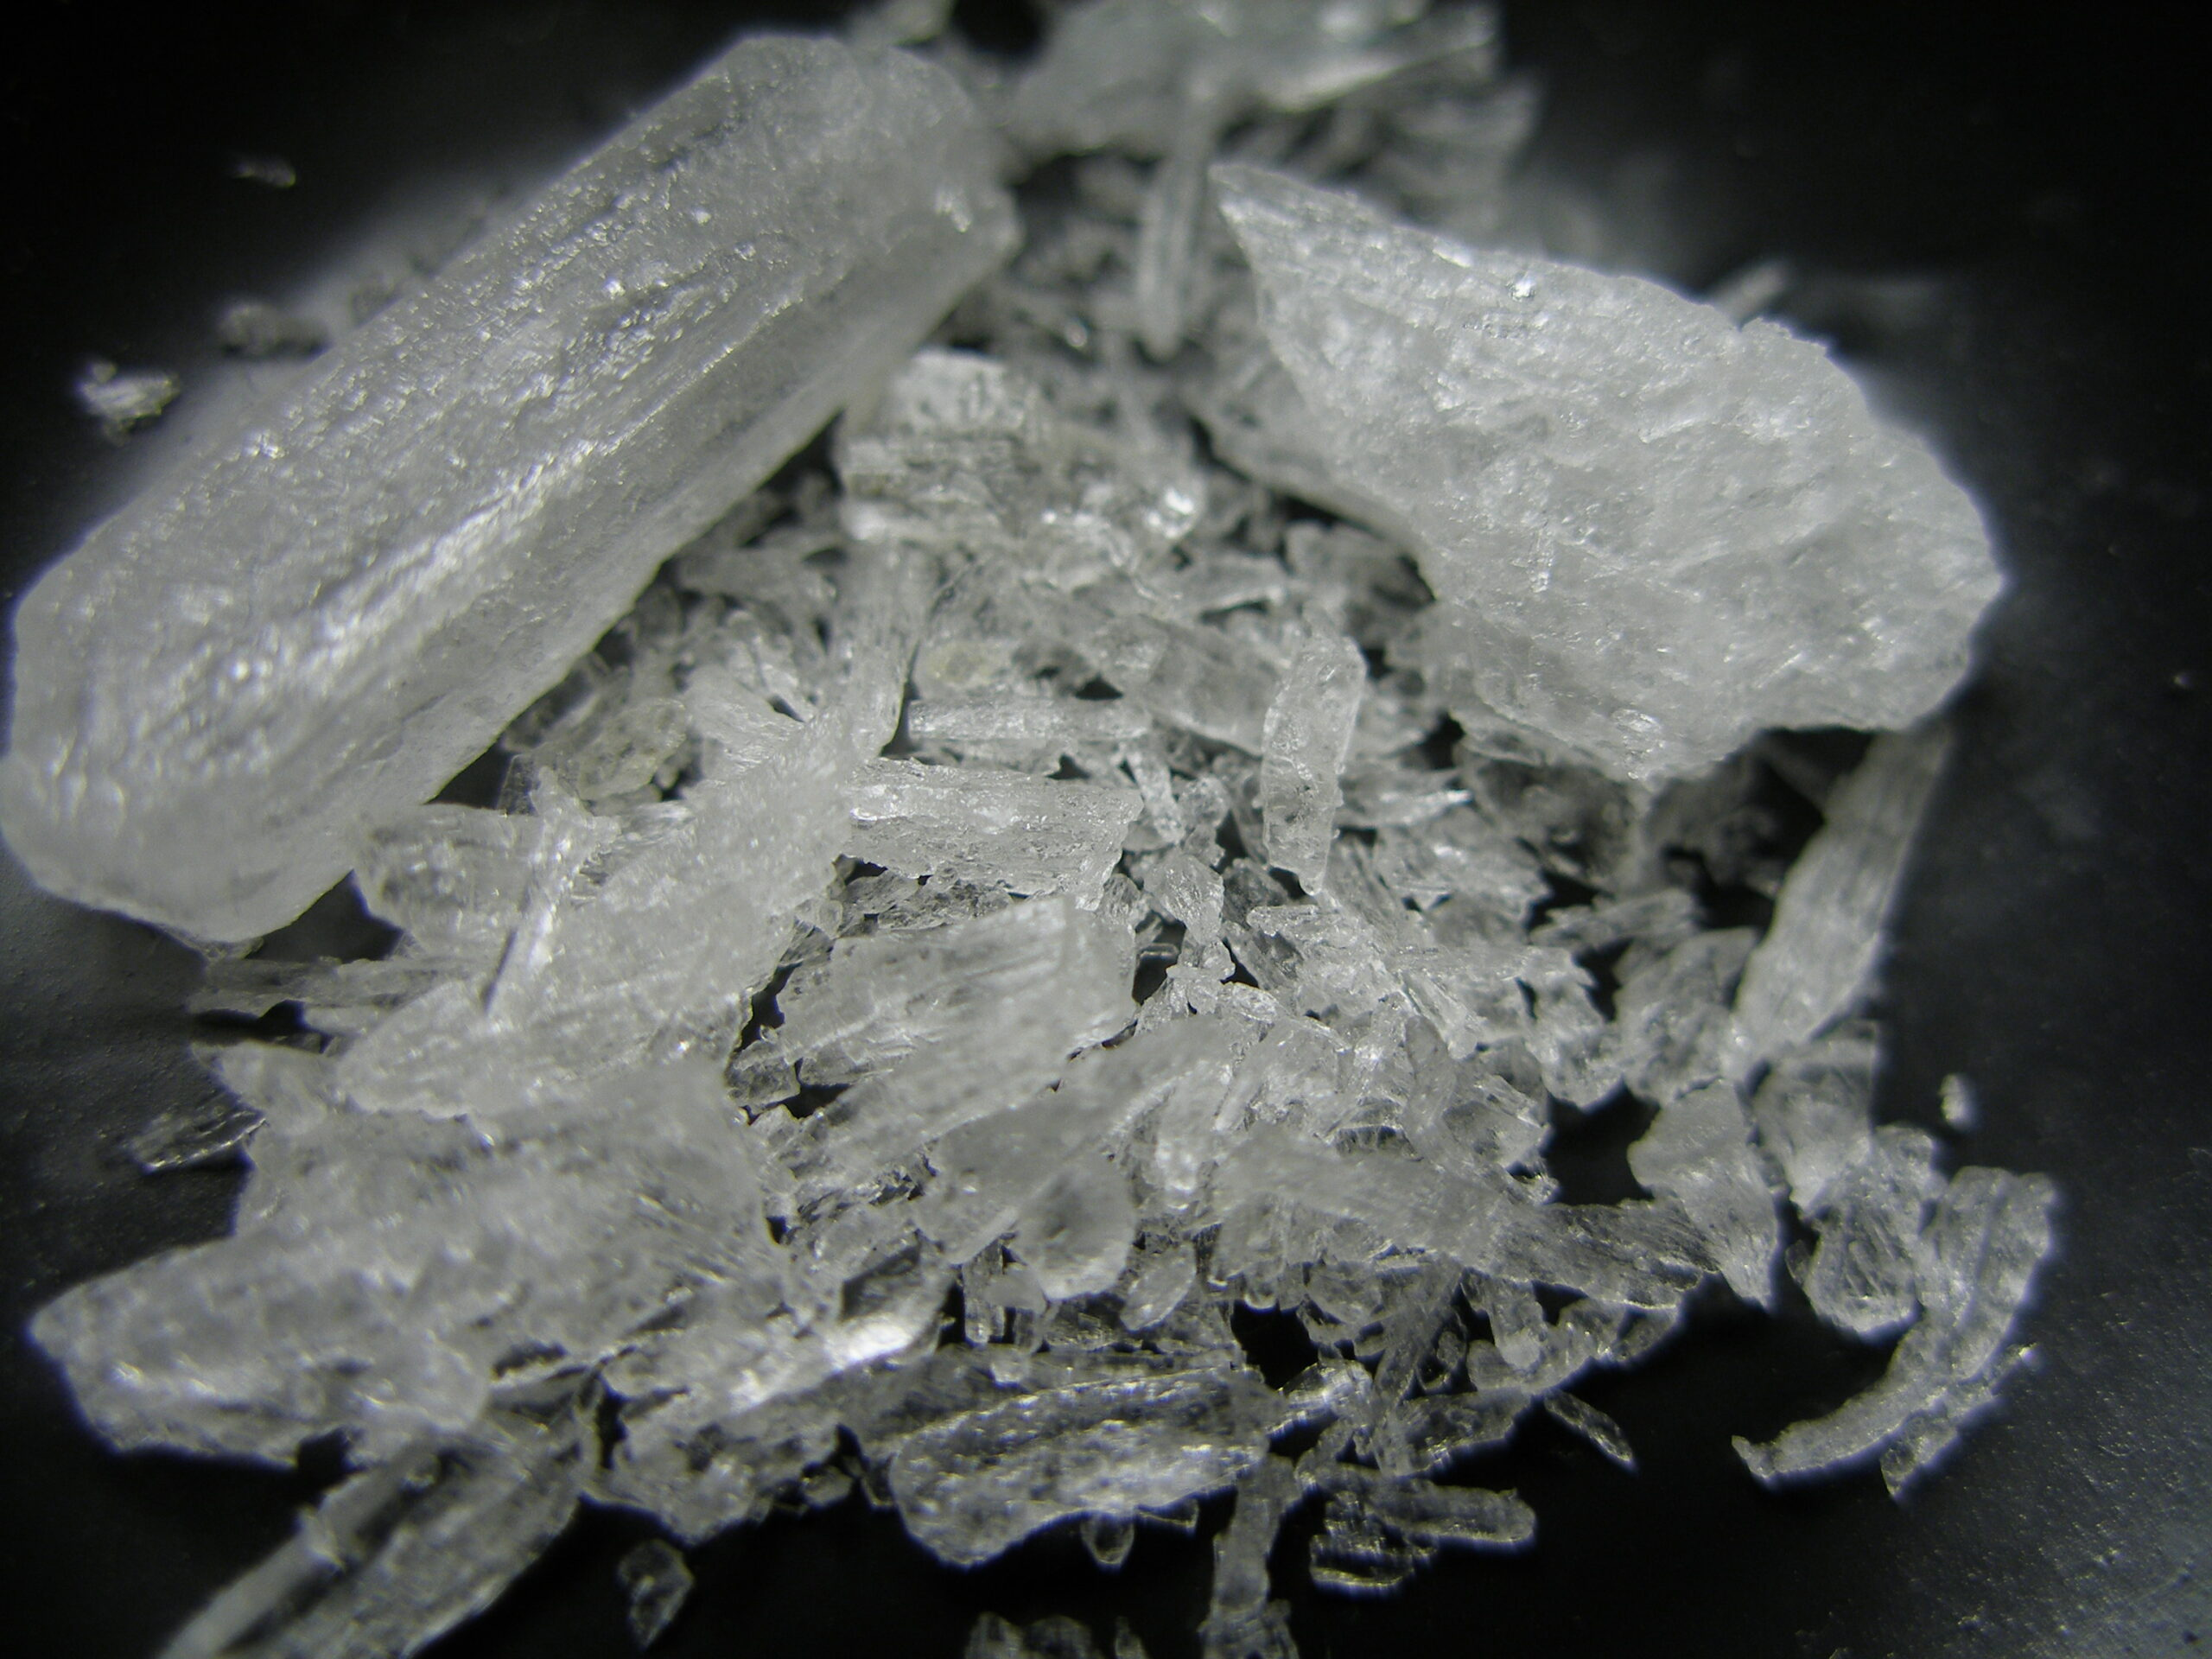
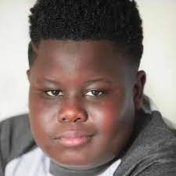
Materials
Text:Used it to make things more simple and to entertain our customers
Pictures:We do not use copyrighted images
Logo:The logo that we used for our webpage
Symbols:The symbols that we used for our webpage
Design:Visual designes

